Slide 1
Dietary Guidelines

Slide 2
YOU ARE WHAT YOU EAT!
The latest studies show that the foods we choose to eat – and not eat can determine one’s short and long term health and quality of their lives.
According to recent statistics, our eating habits play a major role in prevent 4 out of the 10 leading causes of death in America. (heart disease, cancer, stroke and diabetes)

Slide 3
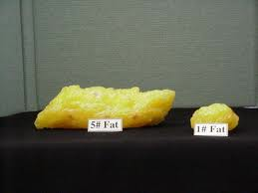
Guidelines to Promote a Long and Healthy Life:
1. Balance the FAT in your diet. Lower the fat intake to no more than 30% of the total daily calorie intake. Reduce cholesterol consumption to no more than 300 mg/day.
2. Balance the sodium in the diet to no more than 2000 – 3000 mg/day.

Slide 4
Guidelines to Promote a Long and Healthy Life: Continued
3. Balance the protein in your diet. Not more than .8 gms/kilogram body weight.
4. Watch the Simple Carbohydrates (simple sugars) in the diet.

Slide 5
Guidelines to Promote a Long and Healthy Life: Continued
5. If you consume caffeine – do so in moderation.
6. Drink 8 – 10 glasses of water a day.

Slide 6
Guidelines to Promote a Long and Healthy Life: Continued
7. Achieve and maintain your specific ideal body weight.
8. Get regular exercise, rest and stress relaxation for total health.

Slide 7
Keys to a Healthful Diet!
Variety
Balance
Moderation

Slide 8
ABC’s of Good Health
A – Aim for good fitness routine
B – Build a healthy daily food plan
C – Choose food options sensibly and in moderation

